Slide 1
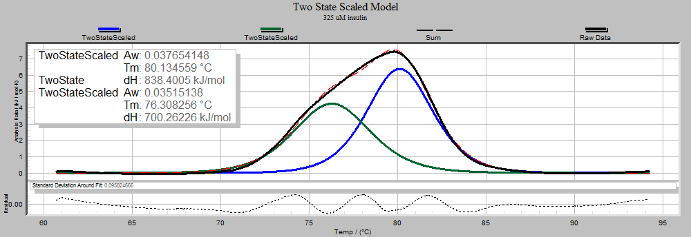
Title of Poster
Designed by Sashikiran’s www.edubuzz360.in
Introduction
Methods
Results
Columns
The columns are there for a guideline. You do not have to use them.
Background Color
To choose a background other than this “GRAY” look: choose Format > slide background / fill then click on desired options and apply.
Scans and Digital Photos
Scans images the size you want them in the poster at 180 dpi. For pictures from your own digital camera, uses the largest file setting.
View your poster at 100% to see if your photos are high enough resolution.
Pictures from the Internet:
Unless you find photos made for down-loading and printing, the resolution is likely to be too low. The photos will not print well.
Only use internet photos with copyright permission. We recommend a stock photography site such as istockphoto.com. You will pay a small fee but have much higher quality images.
Background Photos
If you use a photo for the poster background don’t use a busy, detailed image. It could distract from the text of the poster. The image must be high resolution. A textured background or gradient fill may be a better background option.
Look below & For Order : please mail us the needed content to edubuzz360@gmail.com or Dial us to 9629486910 [ between 6 PM to 6 AM ] Your Design will be ready within 12 Hours from Order !!! Home Delivery , Cash-on-Delivery , Online Payment - All Accepted !!!
OUR DESIGNING SERVICES INCLUDE : 1) Logo Designing 2) Business Cards Designing 3) Certificate Designing 4) Poster Designing 5) Banner Designing 6) Professional Resume Designing 7) 2D , 3D , Animations / Graphics Video Creating 8) Career Guidance 9) Website Designing 10)Website Development
Caption for your photo
Conclusions
Edu Services :
You can email to: sashikiran360@gmail.com to place an order or call us - 9629486910
Please indicate the size ,abstract and other details to design your poster.
www.edubuzz360.in
Indai’s No.1 Education Portal
Objectives
description of this figure
About Backgrounds…
Contrast is important. If your background is dark use white text and make everything bolder. Thin lines will have to be thicker. Fonts that have thin letters might be better bold or in a sans-serif font.
Avoid a “busy” background. It’ll make the text harder to read. Filling a background with a photo is cool but it can easily compete with your information.
If the text doesn’t stand out from the background edit the text block to have a background color. Select the textbox then choose Format Menu / shape/fill: color. Or just put a color box behind the text.
To add an additional heading just copy and paste an existing heading and edit its text.
 | Anxiety | Depression
Physiological | -“Anxiety is so physical” -“Thought I was having a heart attack” -Rapid breathing -Sweating palms -Can’t sleep -Nausea | -Tired -Exhaustion -Loss of appetite
Cognitive | -Racing thoughts | -Downward spiral -Lack of motivation -Pessimism -Worthlessness -Suicidal thoughts
Behavioral | -Restlessness - Can’t sit still -Nail biting -Hair pulling -“You do anything to get rid of it” | -Tearfulness -Isolation -Poor personal hygiene
Affective | -Desperation -Fear -No peace -Urgency | -Sadness -Darkness -Hopelessness
FAST MOVING SERVICES OF THE MONTH : RESUME DESIGNING
We Cost Rs.200 per Page for a Photoshop Resume
& Rs.100 per page for a Professional Word Resume
References
description of this figure
Lastname, James M., & Witte, Kenneth L. (1988). Lasdkjf ;klj sdfkl jlk;jsdf lk;sjdf klj. Bulletin of the Society 12 (4), 325-328.

